Slide 1

Question –Answer Forum
By Group,
VENUS

Slide 2


Slide 3
Contents
Description Of Problem
Objective
Features
Originality And Social Impact
Target Users
Development Timetable
Designing
Reference

Slide 4


Slide 5
Description Of Problem
Internet Provides us lot s of information regarding our problem.
But its difficult to sort which are correct and related in short time period.
So what is the solution to get correct and relevant answer for particular problem?

Slide 6


Slide 7
objective
To Solve the problem Team Venus proposing to build Question-Answer Forum app.
It will help user to get correct and relevant answer to his/her question.
User will get opportunity to become part of discussion and feedback.

Slide 8
Development Timetable
Phase One: Login and Registration Module
Phase Two: User Activity Module
Phase Three: Campus Updates Module
Phase Four: Final Integration of all Modules and Documentation

Slide 9
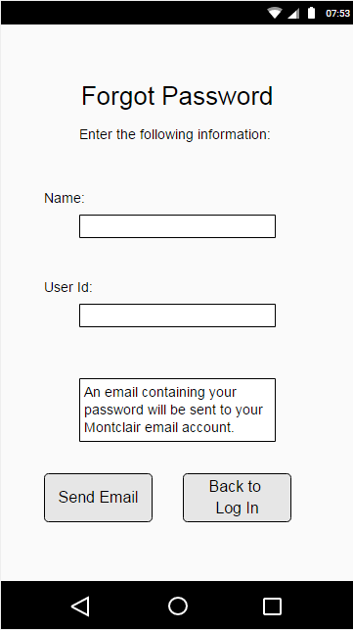
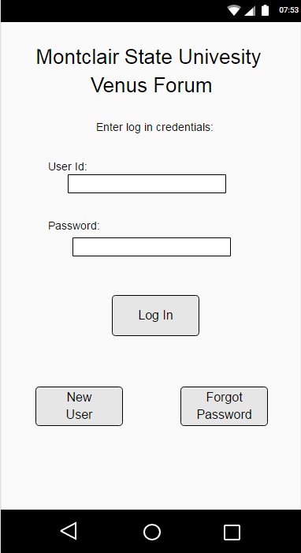
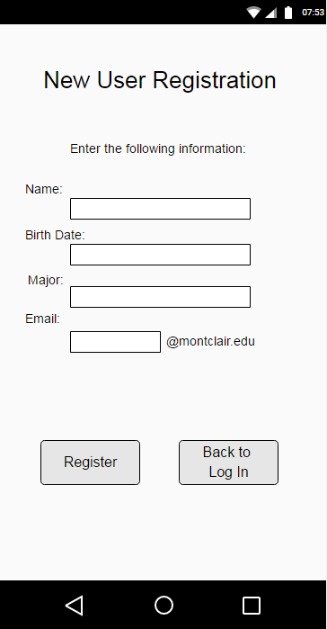
Designs

Slide 10
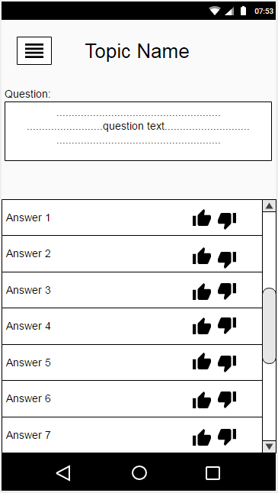
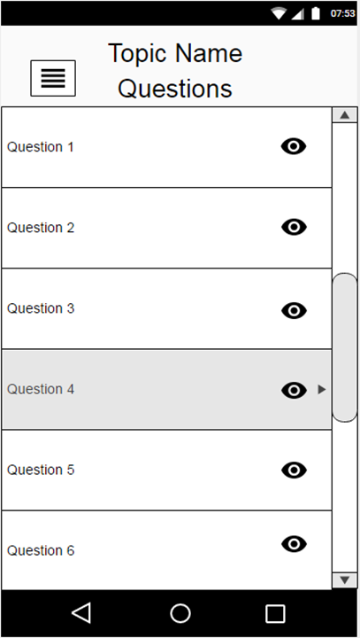
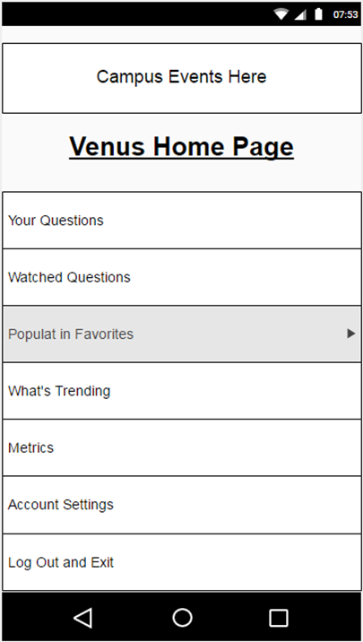
designs

Slide 11
References
Stack Overflow and Quora: like our app, stack overflow and Quora supply their users with an environment to post questions, receive answers, and “like” those answers based on their relevance to a question. Our app will incorporate similar functions, but its primary focus will be Montclair State University students and our extra features will reflect that.

Slide 12


